Slide 1
Planet Hunter
Group Members: Richard Aguilar

Slide 2
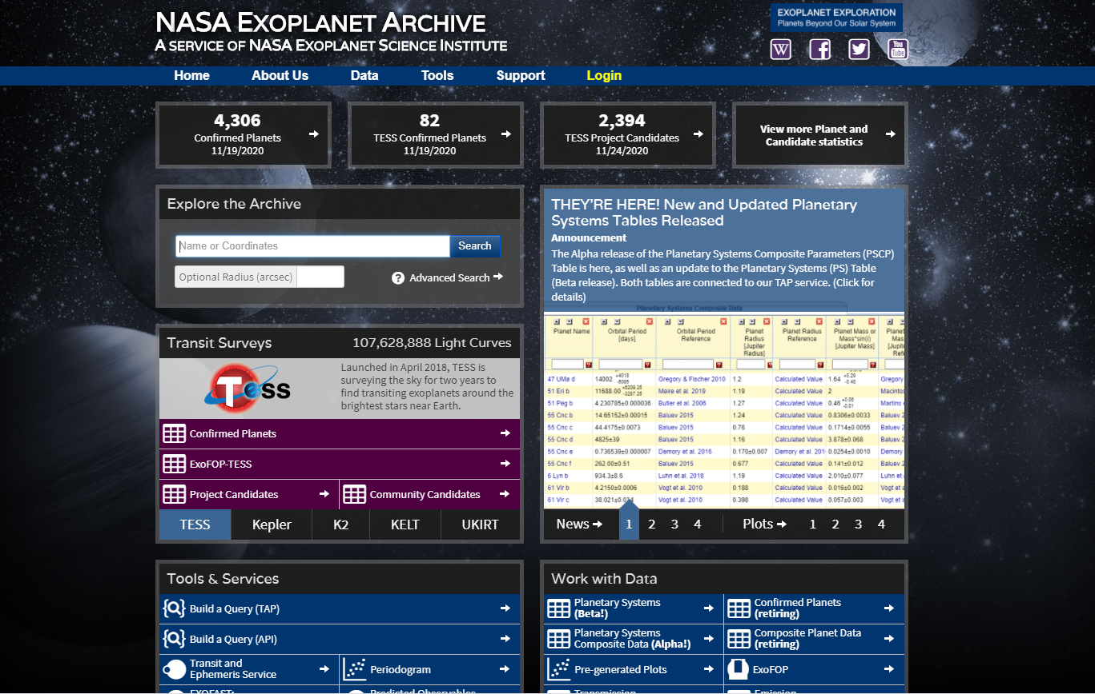
Description
This project will involve using machine learning to detect the existence of extrasolar planets
The dataset used will be from NASA’s exoplanet archive, and specifically from the Kepler Space Telescope.

Slide 3
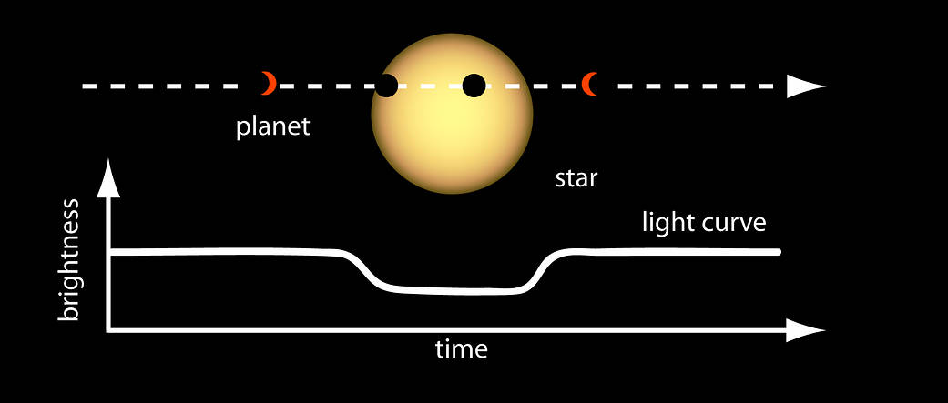
Detection method
Multiple methods to detect planets—radial velocity method, microlensing method, transit method, etc.
Transit method was used by Kepler, and the dataset used will contain planets detected using only this method

Slide 4
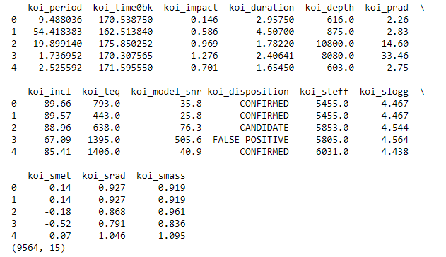
Dataset
Contains 14 features, with 9564 samples.
The first nine denote the characteristics of the planetary body, the last five are details on the stars
Data cleaned during preprocessing

Slide 5
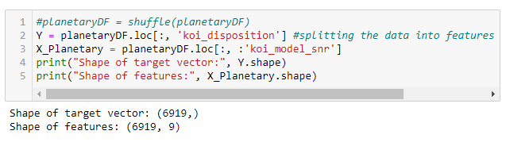
Datatset (continued)
Features span a large range, and have different units of measurement
Standardization necessary
Rows with missing values removed

Slide 6
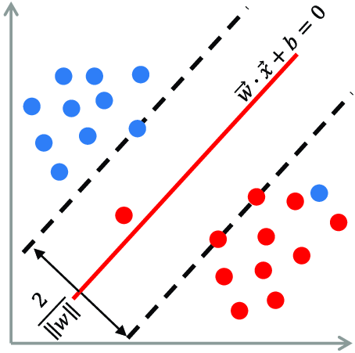
Ml Algorithm #1: Support Vector machines
Dataset contained labels for each sample, perfect for supervised learning
Binary classification problem with outliers
Three versions of SVM used: Linear, Polynomial Kernel, RBF Kernel

Slide 7
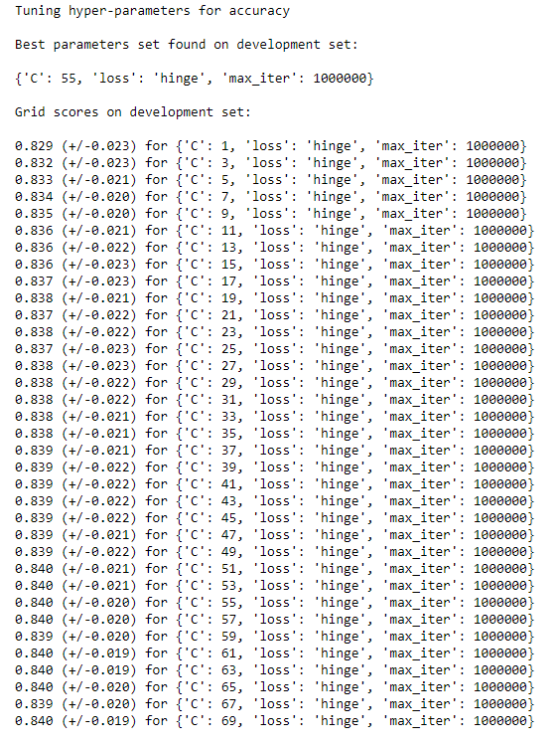
SVM (continued): Hyperparameter tuning for Linear SVM
C, the penalty parameter, is the target for tuning
Grid Search Cross-val used
C = 55 selected as best, gave adequate performance
Accuracy = 81.94%
F1 score = 70.31%

Slide 8
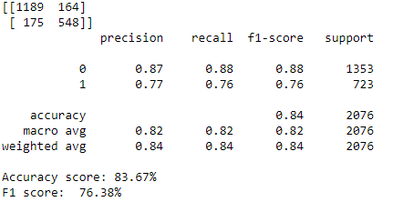
SVM (continued): Polynomial kernel
Grid Search Cross-val used as well for both C and degree
C = 59 selected as best, with polynomial degree = 3.gave
Improved performance but not by much
Accuracy = 83.67%
F1 score = 76.38%

Slide 9
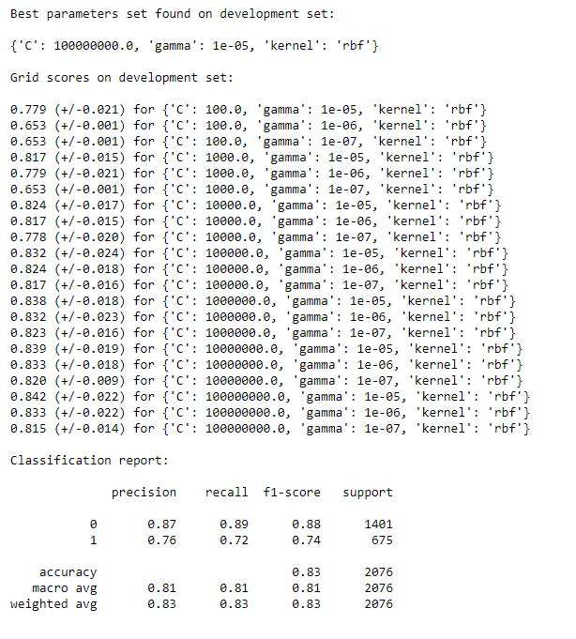
SVM (continued): Radial Basis function
Grid Search Cross-val used as well for both C and gamma
C = 1e8 selected as best, with gamma = 1e-5
No improvement in performance
Accuracy = 83.43%
F1 score = 73.90%

Slide 10
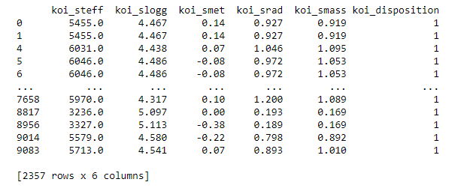
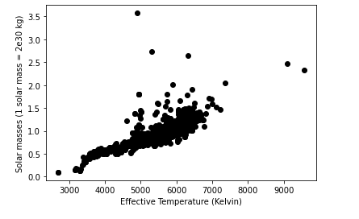
k-means Clustering
Unsupervised learning algorithm
Used stellar data to cluster stars and find similarities
Plotted raw data on 2D graphs to get a sense of spread

Slide 11
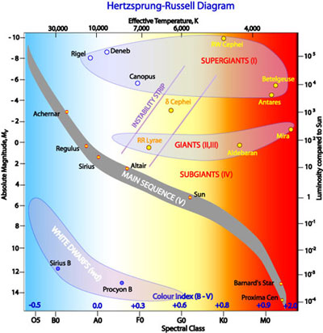
HR - Diagram

Slide 12
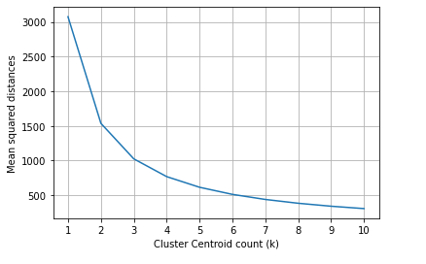
k-means Clustering (continued): Hyperparameter tuning
Value, k, needs to be tuned
Used Elbow Method heuristic
Optimal at k = 3

Slide 13
Conclusion
Support Vector Machine algorithm did not work as well as expected
Performance improved when more sophisticated version of SVM was used (kerneliazed), but not by much
K-Means clustered the stars fairly well. Based on background info, it seems like there were three classes of stars

Slide 14
Related work
Sturrock, George Clayton; Manry, Brychan; and Rafiqi, Sohail (2019) "Machine Learning Pipeline for Exoplanet Classification," SMU Data Science Review: Vol. 2 : No. 1 , Article 9.
Ansdell, M., Ioannou, Y., Osborn, H. P., Sasdelli, M., Smith, J. C., Caldwell, D., . . . Angerhausen, D. (2018). Scientific Domain Knowledge Improves Exoplanet Transit Classification with Deep Learning. The Astrophysical Journal Letters.
Armstrong, D. J., Gamper, J., & Damoulas, T. (2020). Exoplanet Validation with Machine Learning: 50 new validated Kepler planets. Monthly Notices of the Royal Astronomical Society.

